Slide 1
THE ABC's of
Your Intake and Case Management System
for Crisis Nurseries and Daycares

Slide 2
Designed Side-by-Side with Crisis Nursery, Vanessa Behan
“The paperwork was clogging up our relationship with parents. Now we have eleven more minutes to grow our relationships. That’s how change happens.”
Amy Knapton Vega
Executive Director, Vanessa Behan

Slide 3
What is ICMS?
Paperless Intake System
Child and Adult Tracking
Extensive Reporting
Created for efficient processes
Let software do the tracking
Designed for grant writing
Move beyond paper and transition to an easy-to-use app that allows you to maximize your time spent with clients.
Maximize your team's influence by focusing on relationships while tracking vital details about children and their caregivers.
Reporting features in ICMS make measuring outcomes much easier. Deidentified data can be exported for custom reports.

Slide 4
Cost Break Down
Initial
$5,000 for set up, training, and 1st year of maintenance
Microsoft provides Azure credits to non-profits
Yearly
$1,000 annually for support, maintenance, and upgrades

Slide 5
Technical Aspects
Secure data stored your in private cloud
All data encrypted during transport and while at rest in the database
Access controlled via a unique username, password and PIN code
Activity logs allow for simple, trackable database changes
Workflows track alternations in all key documents
Room screens use icons to protect sensitive information
Presentations are communication tools that can be used as demonstrations, lectures, speeches, reports, and more. It is mostly presented before an audience. You can include photos of your team, descriptions of products, or your goals as a company.

Slide 6
Need Detailed Reports?
ICMS has you covered!
Child Stays – types of occupancy totals and hours of care
Parent Stress Levels – at intake and discharge
Intake and Discharge – statistics, timing, and totals
Distinct and New Households
Distinct and New Children
Turnaways – new intake and extension with reasons
Dependents of the State – intakes and turnaways
Adult Follow-ups – creation, completion, etc.
Resources Recommended – types recommended
Demographic Info – use reasons, income, ethnicity, etc.
Meal Statistics – servings, times offered, allergies, etc.
Baby Food – ingredients, average amount eaten, etc.
Data Export - for building your own custom reports
Presentations are communication tools that can be used as demonstrations, lectures, speeches, reports, and more. It is mostly presented before an audience. You can include photos of your team, descriptions of products, or your goals as a company.

Slide 7
ICMS Wins for Your Team
Get Rid of Paper
Easy Metrics for Grant Writing
Streamline Your Operations
Configure for Your Needs
Maximize Care for Kids
ICMS helps crisis nurseries reach their full potential by providing a robust, automated system for child care.

Slide 8
Get in Touch with Us
Questions?
Customized Demo?
ICMS Test Drive?
Email
Website
icmsinfo@intellitect.com
intellitect.com/icms

Slide 9
Have More Questions?
Check Out these Additional Slides

Slide 10
Intake
Calls
Scheduling
Intake Process
Organize and catalog all calls received by type of call with a focus on follow-up and ongoing care and assistance.
Stay in compliance with the staff-to-child ratio by viewing real-time staff availability. See who is coming, who is already here, who will be leaving, and who has recently left.​
Information is gathered during the child’s first visit then saved and confirmed during future visits.

Slide 11
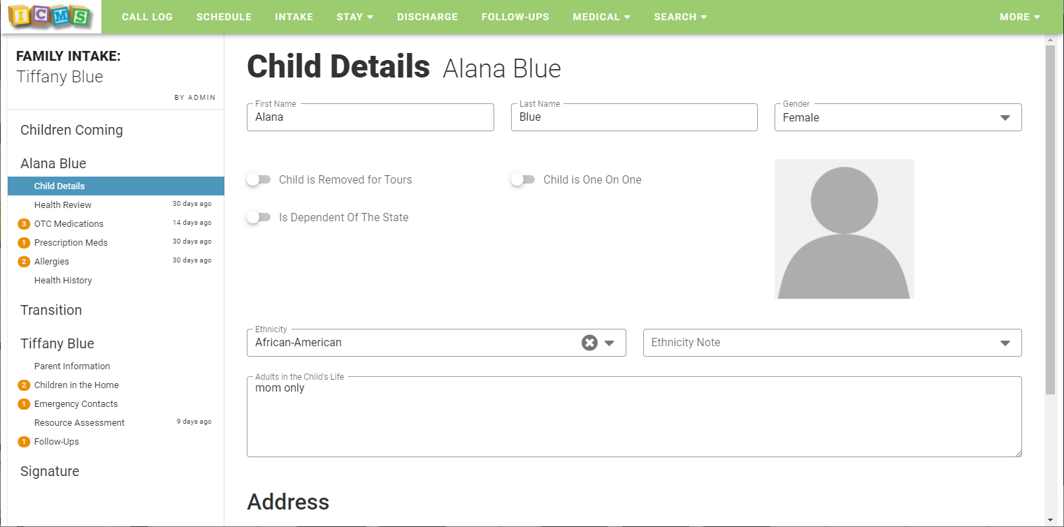
Intake Screen

Slide 12
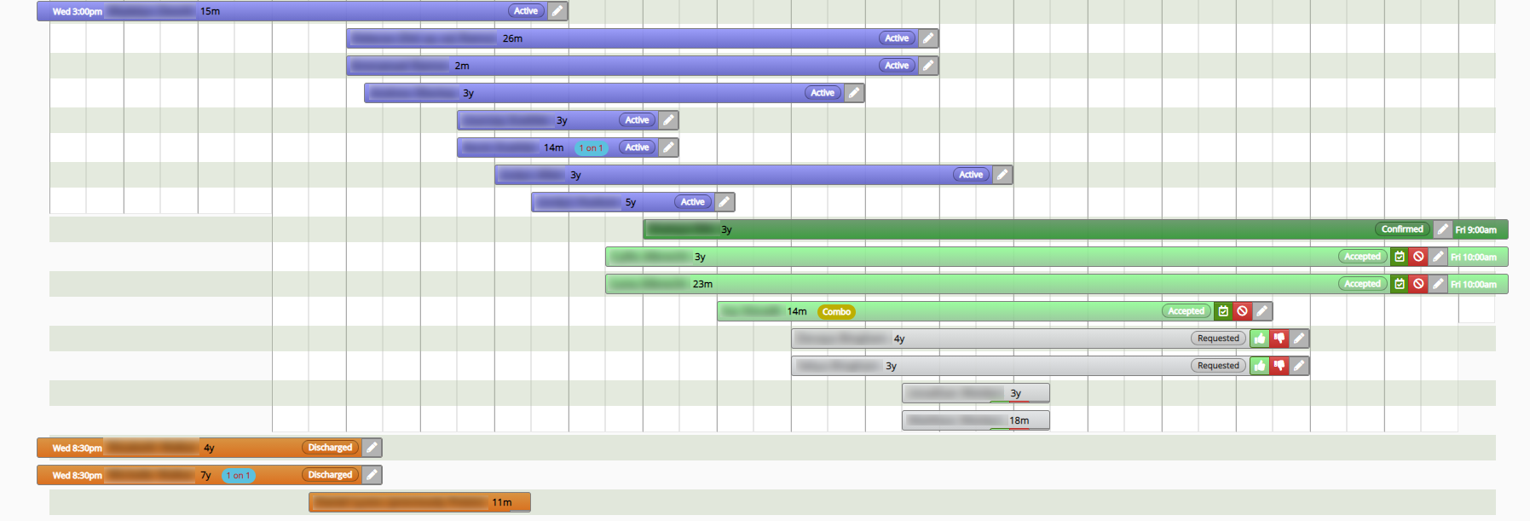
Schedule Screen

Slide 13
Child Management
Status Board
Activities
Meals
Limit risk and display vital child info on televisions around the nursery. Icons denote needed medications, allergies, and more.
Record, review, and modify notes and daily activities. Also, fill out disclosures as well as incident and behavior reports.
Track meals, record food logs, and note allergies. Supports bottles, baby food, and other types of meal tracking.

Slide 14
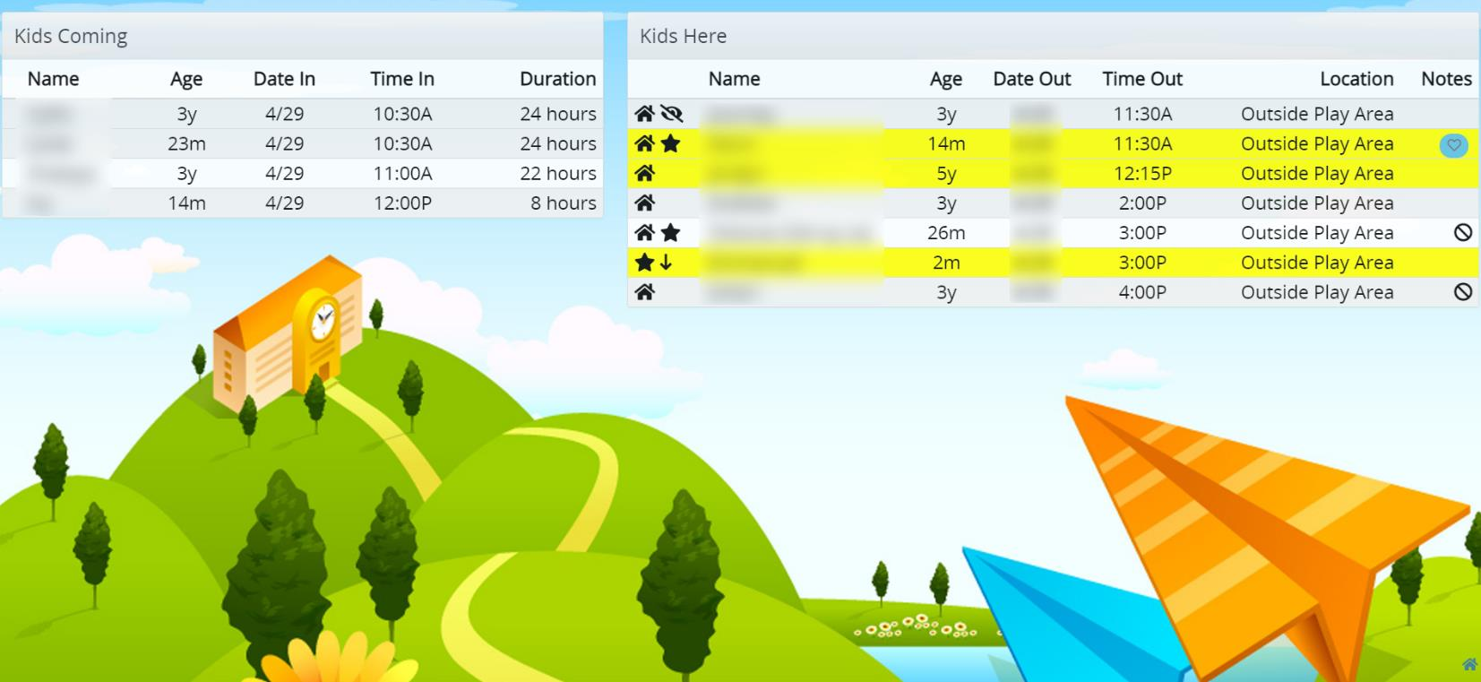
Status Dashboard

Slide 15
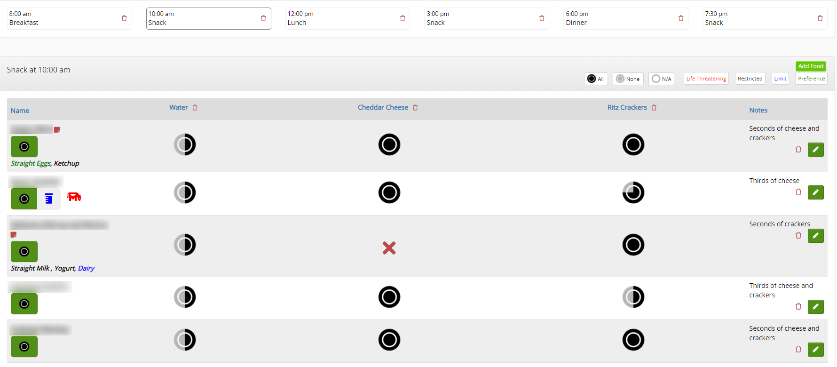
Meals Screen

Slide 16
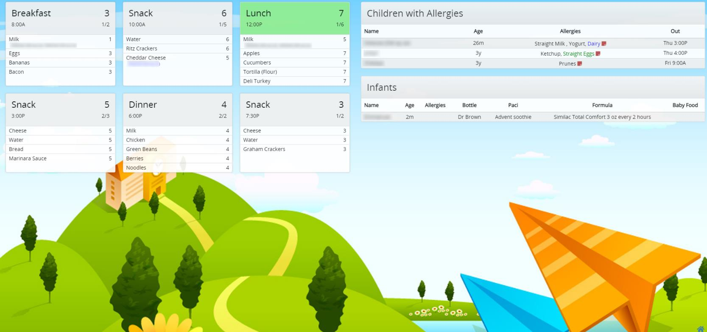
Kitchen Dashboard

Slide 17
Child Info
Key Info
Demographics
Allergies/Meds
Record detailed child and caregiver information in one customizable, user-friendly intake page.
Record key demographics info including ethnicity, address, etc., for grant writing during intake.
Quickly and accurately view and manage which child has allergies and to what foods or items.

Slide 18
After Care
Discharge
Follow Up
Referrals
Checking in and out is a breeze with a list of the current kids and pick-up information.
ICMS tracks your follow-up opportunities and prompts staff about these at appropriate times.
ICMS makes partnering with community organizations for long-term change easy and trackable.

Slide 19
Workflows
Incidents and Disclosures
Objective Records and Workflow
Medication and Allergen Reviews
Recording concerns is simple. The app alerts appropriate supervisors for review and response.
Create and verify objective write-ups with the customizable workflow system.
All medications and allergens can be reviewed by staff via a workflow system.

Slide 20
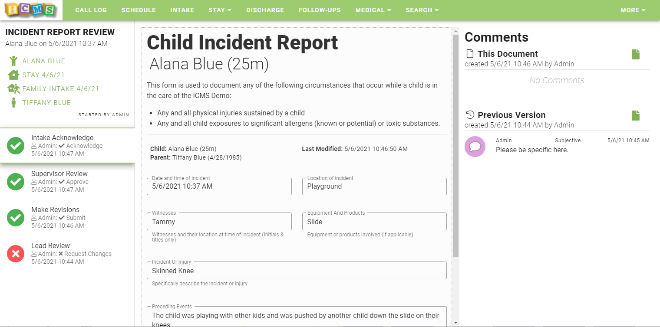
Workflow

Slide 21
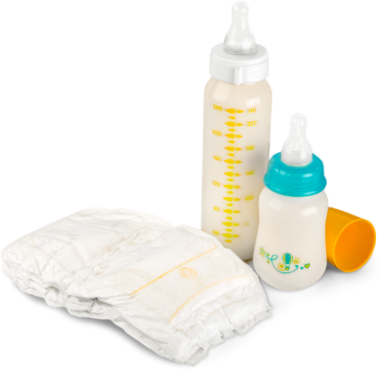
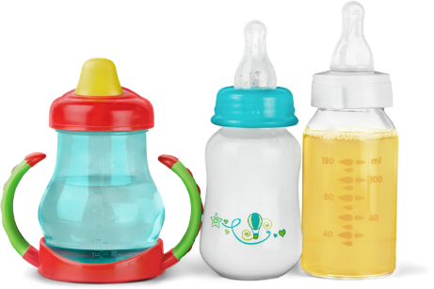
Reports
Grants
Interaction Notes
Meals
Provide data for state-mandated reporting and grant applications. Easily upload files into the system.
Staff can record notes on interactions that are reviewed by staff for objectivity via the workflow process.
Track meal times, how much a child eats, ingredients used, formula type, and much more.

Slide 22
Thanks for Your Time!
Questions?
Customized Demo?
ICMS Test Drive?
Email
Website
icmsinfo@intellitect.com
intellitect.com/icms

